Slide 1
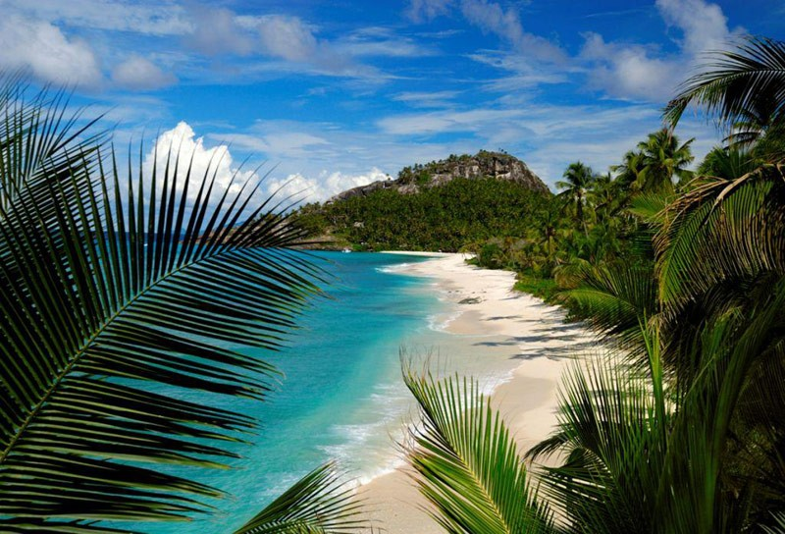
Seychelles Islands

Slide 2
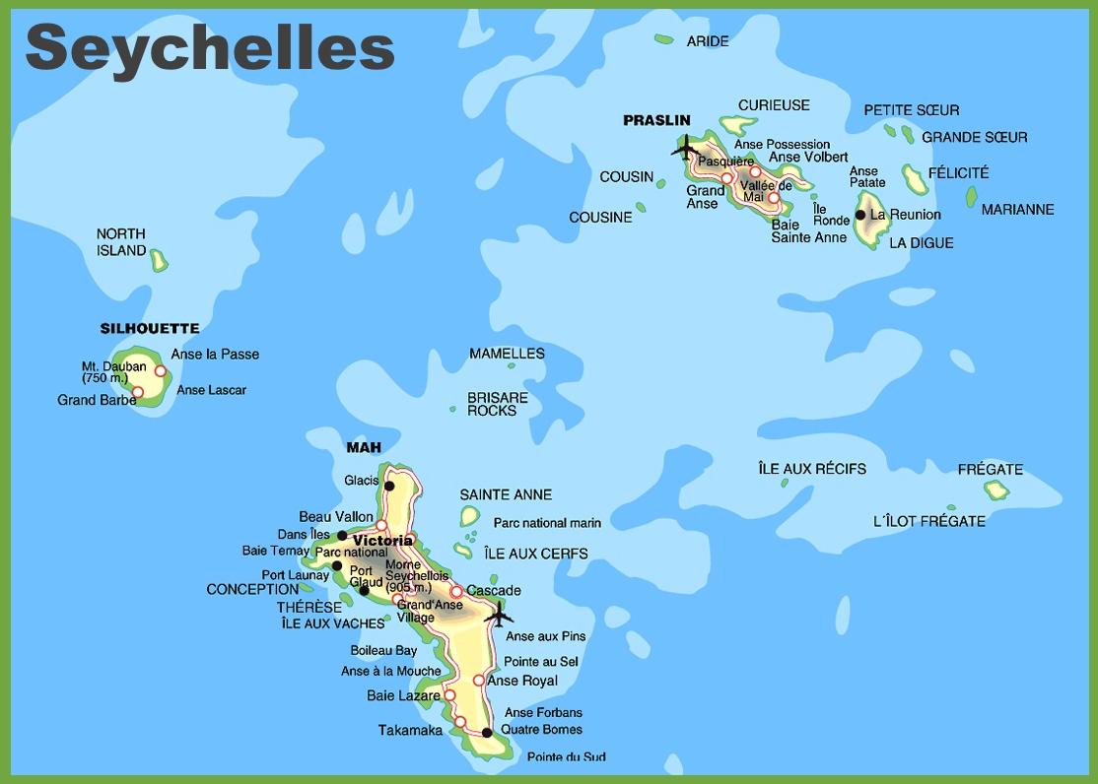

Slide 3
Seychelles –
where royals honeymoon

Slide 4
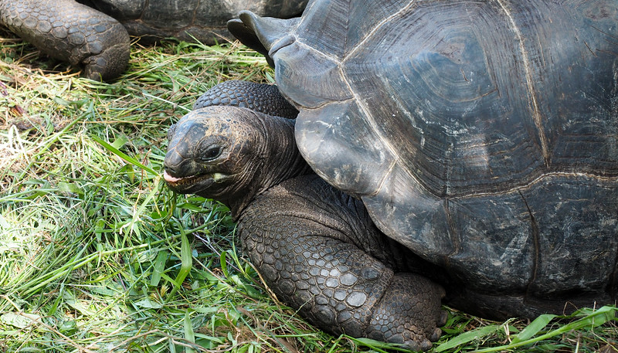
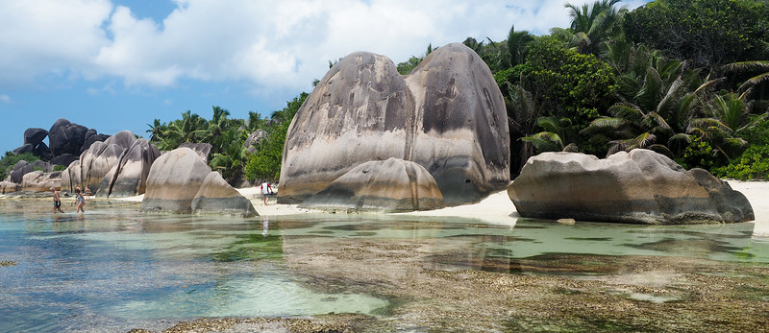
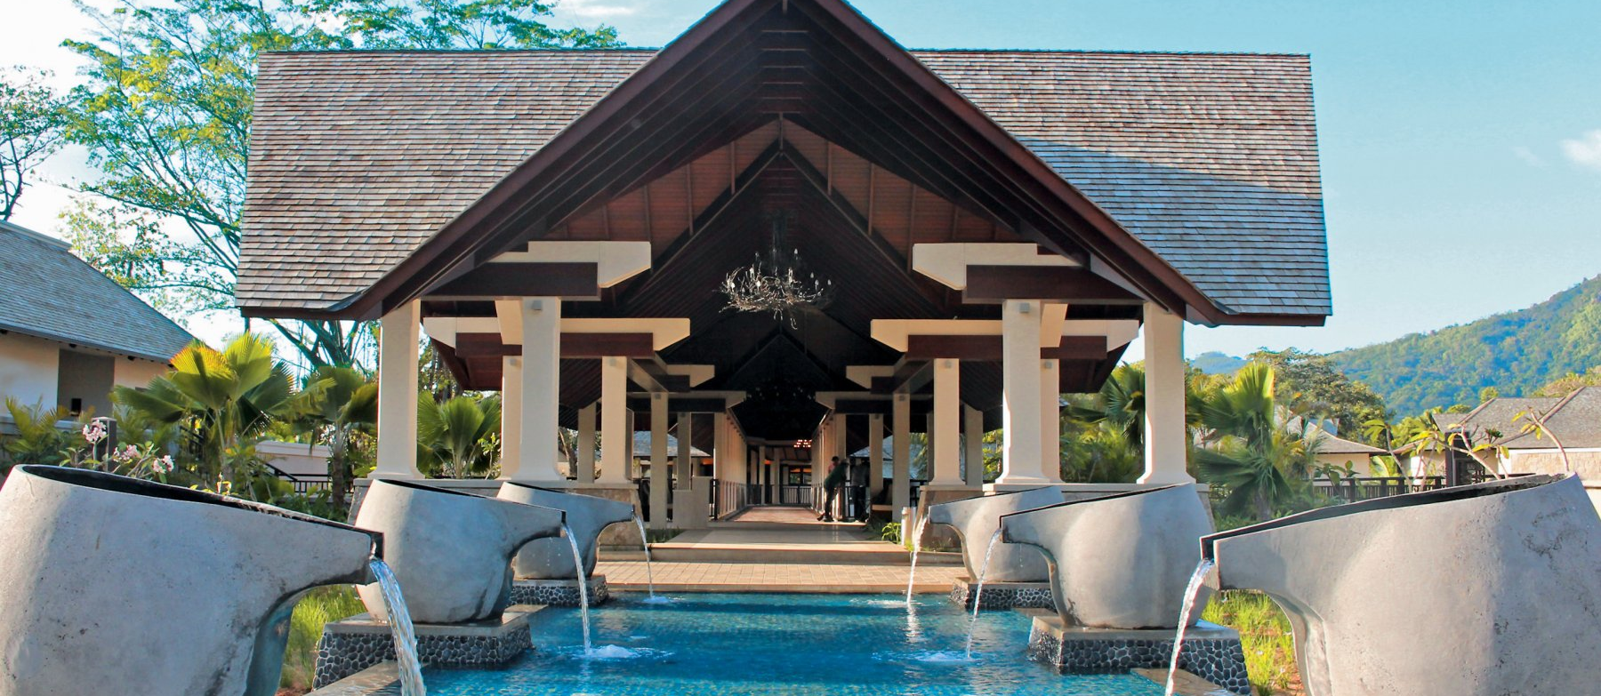
Cool native wildlife – like the Aldabra giant tortoise
Visit the Seychelles for the . . . .
Beaches – 65 incredible beaches on just Mahe Island!
French influenced - African culture and cuisine
Affordable luxury resorts

Slide 5
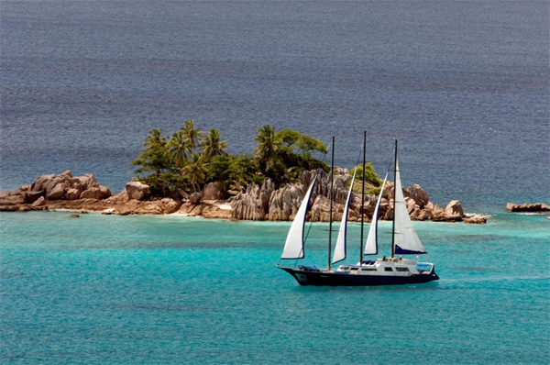
Sailing the Seychelles
115 Islands
The Outer Islands include 72 coral islands that arc towards the West Cost of Africa in six island groups. All islands lie “between 260 and 865 miles from the east coast of Africa”
Main islands of Praslin, La Digue and Mahe
Source: https://www.seychelles.org/sailing-seychelles

Slide 6
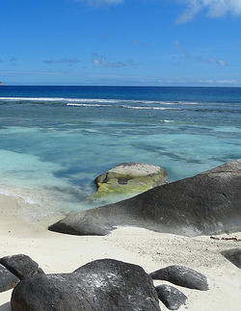
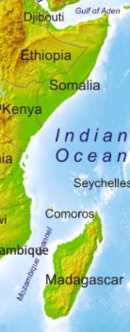
The Problem
International pressure and naval presence pushed pirates around the horn of Africa and Somalia south to the Seychelles Islands.
In 2010, sailors were kidnapped just north of the Seychelle capital Mahe.
NATO instituted Operation Ocean Shield to insure safe passage.

Slide 7
PIRATES

Slide 8
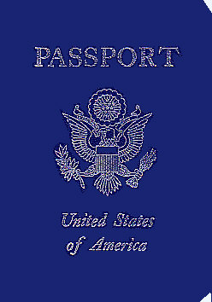
All foreign vessels must arrive and depart from Port Victoria on Mahe Island
Checking in with customs helps keeps sailors safe.
Traveling around the archipelago is safe
Avoid sailing alone on the open sea north of the Seychelles
http://www.seychelles.org/sailing-seychelles

Slide 9
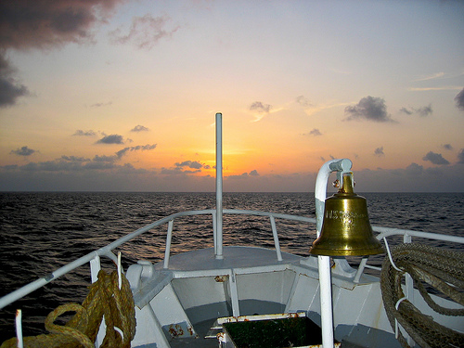
Miles of Scenic Coastlines to Explore
The thrill of sailing the waters of the Seychelles is using compass, charts, and knowledge.
Largest offshore rocks are visible to the eye
Personal yachts should only travel by day
Navigation aids available

Slide 10
The Seychelles Islands Piracy Policy
Seychelles National Assembly prosecutes pirates
Universal jurisdiction allows the Seychelles to put on trial captured pirates from other countries, like Somalia
To date, the Seychelles have prosecuted the most pirates
142 pirates
17 piracy trails
http://www.marsecreview.com/2015/10/the-seychelles-anti-piracy-model/
Visitors &
Sailors
Still
Need
To Be
Cautious

Slide 11
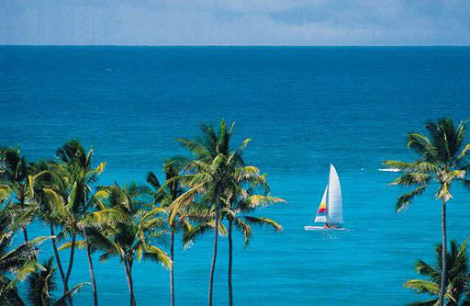
Enjoy the Seychelles!
Be prepared with supplies on board.
Be watchful of other boats.
Travel with other
yachts.
Do
not
be a
victim
of piracy!

Slide 12
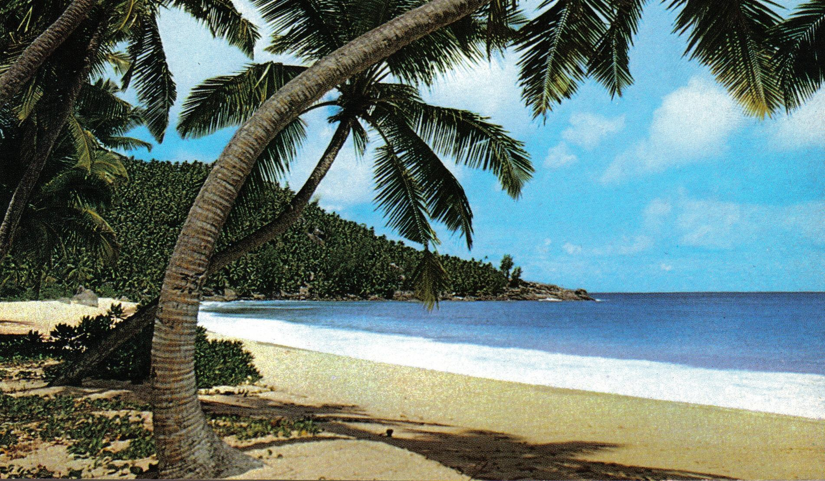
This message brought to you from SeyNoPirates.org Call us +245-4294-500.

