Slide 1
Conclusions
the end of it all

Slide 2
A Metaphor
Although desserts taste delicious at any time of day, there’s a reason why we eat them after dinner: they’re the grand finale that leave us with a good impression of the meal we just had.
A conclusion should also leave us feeling content, impressed, and maybe, even inspired. Even if all the body paragraphs are fantastic, if you put a boring or incomplete conclusion at the end, the reader will walk away with a negative final impression of your work. This is why some restaurants give free mints or chocolates with the check: customer satisfaction and building a positive relationship!

Slide 3
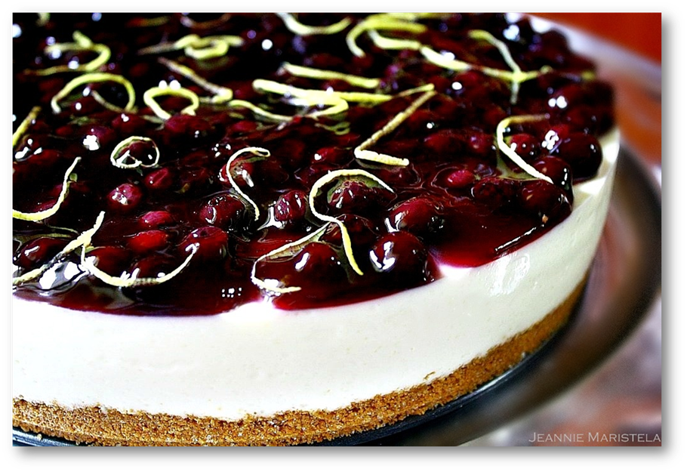
Recipe for a Good Conclusion:
Pie crust: Restate the thesis using new words (paraphrase)
Cheesecake: Review the major points of the essay concisely and using new words
Whipped cream: Mention the legacy, significance, lessons we can learn, predictions for the future, or other “takeaways” (the “so what” of your research paper)
Blueberry garnish: A final statement that is a call to action or thought to ponder.

Slide 4
Words of caution . . .
Think about portion control! You don’t want the reader to still feel hungry (too short) or stuffed to the point that she’s going to be sick (too long).
1
Stay consistent with the tone and style of the paper. Don’t suddenly shift into wording that is more or less formal than before.
2
Do not introduce new facts for the first time. Rather, this is the time to analyze facts that were already stated, restate or maybe even synthesize multiple facts to make big general statements.
3
Don’t let anything in your conclusion be random or off topic.
4

Slide 5
Sample thesis restatement
Thesis: Supporting public radio is vital to a well-connected and informed community.
Conclusion: Small towns across America need the connection and information provided by public radio.

Slide 6
Start the Conclusion with a Quote
This works well if you opened with a quotation and can quote from the same person again.
Thesis: Scientists are not exactly sure why humans need sleep, but lack of sleep has detrimental effects on a person's health.
Conclusion: Until scientists unravel the mystery of sleep, perhaps it’s best to think of it as Shakespeare did when he wrote the following in Macbeth: “Sleep that knits up the ravel’d sleave of care,/ the death of each day’s life . . . balm of hurt minds . . . chief nourisher in life’s feast.” Scientists do know that sleep is key to proper brain function and to embed new knowledge. Sleep nourishes the body as well as the mind with minimal to tragic effects if missing. In the feast of life, sleep nourishes the body, soul and mind.

Slide 7
Quote
Introduction Hook
Albert Einstein once said, "Any man who can drive safely while kissing a pretty girl is simply not giving the kiss the attention it deserves."
Conclusion
It doesn't take an Einstein to realize that cell phones are not the first, nor will they be the last, driving distraction. We don't need more restrictions on cell phones; we just need better drivers.

Slide 8
Call to Action
Ask the reader to take action.
Thesis: The territorial defensive behavior of peregrine falcons fluctuates based on three factors: the time of year, the breeding cycle, and the cause for defense.
Conclusion: Much remains to be learned about these fierce, beautiful fighters. Please help with conservation efforts by joining The Peregrine Fund, a non-profit organization dedicated to protecting birds of prey.

Slide 9
Call to Action
Ask the reader to take action.
Thesis: Ethiopians are victims of climate change, government corruption and the inadequacies of humanitarian aid.
Conclusion: The people of Ethiopia suffer from a trifecta of misfortune: drought, corruption, and insufficient aid. Can we blame the victims? I don’t think so. We can help Ethiopians. One way is through donations to non-profit humanitarian organizations, like One. Another way hits closer to home. If we all make the decision to decrease our personal contribution to global warming.

